Slide 1
API Gateway Pattern
Ocelot is an open-source API Gateway built on top of ASP.NET Core, designed for .NET microservices architecture.
It provides a unified entry point to a system composed of multiple services.
Ocelot is a lightweight API Gateway for ASP.NET Core. It acts as a reverse proxy and routing service, commonly used in microservice architectures to:
Route requests to downstream services
Aggregate multiple responses
Handle authentication/authorization
Enable logging, rate limiting, and caching
When you have multiple microservices running on different ports, managing routes, authentication, and security becomes complex. An API Gateway like Ocelot helps

Slide 2
API Gateway Pattern
🧩 Feature | 🔍 Purpose
Reverse Proxy | Forwards client requests to appropriate downstream services
Routing | Maps external URLs to internal services
Load Balancing | Distributes traffic across service instances
Authentication / JWT | Centralized login and token validation
Request Aggregation | Combines responses from multiple services
Caching / Rate Limiting | Controls traffic and reduces server load
Logging and Tracing | Centralized request logs for monitoring

Slide 3
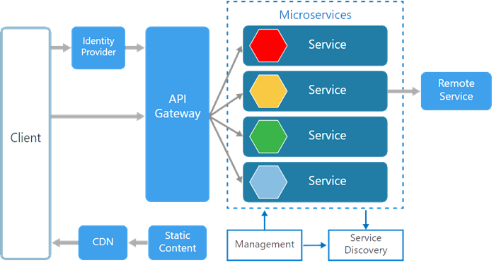
Building API Gateway Using Ocelot In ASP.NET Core

Slide 4
Ocelot In ASP.NET Core
Ocelot Features
Routing the Incoming Request to the required Microservice
Authentication & Authorization using JWT
Load Balancing
Logging
Service Discovery with Consul & Eureka

Slide 5
⚙️ Key Components of Ocelot
1. Upstream
The request made by a client to the gateway
Example: GET https://api.myapp.com/products
2. Downstream
The request Ocelot makes to a microservice
Example: GET http://localhost:8002/api/products
3. Routes
Define how upstream requests are forwarded to downstream services
Includes templates, allowed methods, headers, authentication, etc.
4. GlobalConfiguration
Base URL for Ocelot
Configuration applied across all routes

Slide 6
Configuring Ocelot Routes
{
"Routes": [
{
"DownstreamPathTemplate": "/api/products",
"DownstreamScheme": "http",
"DownstreamHostAndPorts": [
{ "Host": "localhost", "Port": 8002 }
],
"UpstreamPathTemplate": "/products",
"UpstreamHttpMethod": [ "GET" ]
}
],
"GlobalConfiguration": {
"BaseUrl": "https://localhost:5000"
}
}

Slide 7
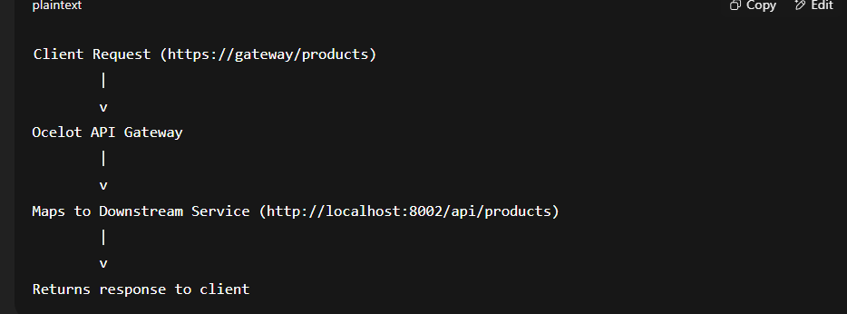
How Ocelot Works (Flow Diagram)

